Slide 1
Business Economics
Marcelo Ortiz M.

Slide 2
Topic 4: Teams and Decision Rights
Objectives:
1) Explain how works vary in their assignment of tasks and decision authority
2) Understand the trade-off between centralization and decentralization
3) Understand the trade-off between vertical and horizontal decision right assignment
4) Compare decision management rights and decision control rights
5) Understand influence cost and its role in decision rights assignment

Slide 3
From tasks to jobs
The process of transforming inputs into products/services is composed of several tasks
Car company: design, buying inputs, assembling, painting, selling.
Each of them can be subdivided: design of electronic parts, seats, etc.
Organization architecture: jobs are created by bundling together different tasks
Dimensions of a job:
(1) Variety of tasks
(2) Decision authority (to determine when and how to complete each task)

Slide 4
From tasks to jobs
2
Secretary
4
General Manager/CEO
Variety of task
1
Office receptionist
3
Sales manager
Decision authority
Notes:
Receptionist: welcoming guests, informing employee about the visit, informing the visit where to go, reception of posts and packages-
Secretary: maybe the same plus managing office calendar, coordinating meetings preparations, payments.

Slide 5
From tasks to jobs
Unfortunately, the problem of bundling tasks into jobs is extremely complex. It involves the assignment of literally thousands of tasks and decision rights
It also involves simultaneous consideration of other corporate policies such as performance-evaluation and compensation policy—the other two legs of the organizational architecture tool
Although the current theory is not sufficiently well developed to provide a detailed solution to this general problem, through some relatively simple examples we can derive important insights
In this topic, we focus on the issue of decision authority

Slide 6
Centralization vs Decentralization
Suppose you own a company that sells car in Barcelona and Madrid. You have hired two local managers, Xavier and José, one for each city. For simplicity, let’s consider a single task: pricing each sale.
Assigning an individual the task of setting prices at a local unit increases that person's decision-making authority.
So, who should set the final price of each car?
Options:
1) You (general manager)
2) Xavier and José as a team
3) Xavier or José
4) Xavier and Javier separately for their own cities

Slide 7
Centralization vs Decentralization
Lets compare the two extreme options: fully centralized and decentralized
Benefits of decentralization | Costs of decentralization
- Better use of local/specific knowledge: geographic, technical. - Conservation of senior management time - Training and motivation for local managers | - Incentive problems (e.g., delaying/hiding bad news, perquisite taking) - Coordination costs and failures (externalities, missing synergies) - Less effective use of central information (eg., info about suppliers) - Forgone scale economies (eg., advertising)

Slide 8
Centralization vs Decentralization
Discuss the benefits/costs of centralizing product design in a small electronic manufacturer producing just two products (notebook and tablet) with two designers.

Slide 9
Centralization vs Decentralization
These costs and benefits are likely to vary across firms and time.
Across firms:
Technology
Market condition/discipline
Regulation
Firm diversification
Firm vertical integration
Level of coordination across firm’s units

Slide 10
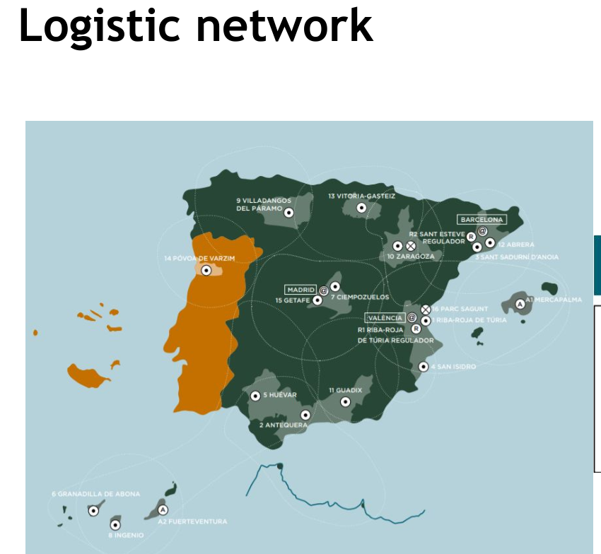
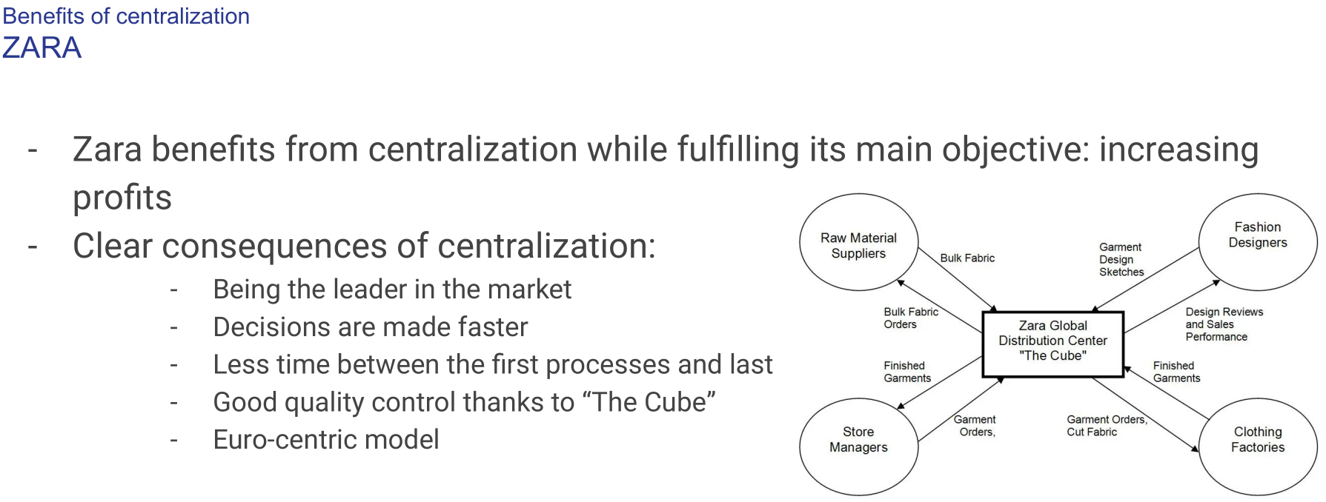

Centralization vs Decentralization
The same analysis applies when we move the focus from the job to the business department level:
For example: Can we use this theory to explain differences in the decision right distribution in Logistics Department across companies?
Notes:
Objective of logistics: planning and implementing the movements of goods for timely deliver at the lowest costs.

Slide 11
Horizontal (lateral) decision rights
In case of decentralization, there are also horizontal decision rights to assign:
In our example, lateral rights can be allocated across local managers
1) each manager make pricing decisions for its city
2) one manager makes pricing decisions for both cities
3) both managers make pricing decisions as a team
The correct organizational architecture depends on the magnitudes of 3 costs:
1) cost of distribution of specific knowledge needed for taking the correct decision
2) coordination costs and failures across units: how critical coordination is? Consequences of failure?
3) monitoring/control costs: how costly is to confirm the correct decision has been taken?

Slide 12
Horizontal (lateral) decision rights
Describe how these factors apply of each of the 3 organizational options for lateral decision rights in our examples
  Pricing
  Product design

Slide 13
Centralization vs Decentralization
Team: a work group with decision authority
Team decision-making: usually about managing activities, providing evaluation or suggestion, development new projects/products
Managing activities: multiple divisions/knowledge, coordinating production or working schedules, launching new products
Benefits | Costs
- Improved use of dispersed specific knowledge - Employee buy-in | - Collective action problem (slow decision making! And even inefficient) - Free-rider problem

Slide 14
Decision Management and Control
So far we have simplified the analysis: we assumed that an employee either has a decision right or does not
We can divide this concept into 4 components:
Decision management:
1) initiation: generation of proposals for new initiatives or changes
2) implementation: execution of the decision
Decision Control:
1) ratification: choice the initiative to be implemented
2) monitoring: measuring performance and implementation of rewards
Develop these concepts for our previous two examples:
- pricing
- product design
Notes:
Este es un cambio de tema.
Quizas este tema debería ir al inicio? Antes de centralization?

Slide 15
Decision Management and Control
The main recommendation is to separate decision control and management among different agents/teams
Example: Xavier might price below the fair price if a friend is the client.
Only when the decision-maker has the legal rights to the profits generated by its decision is it recommendable to keep decision control and management together.

Slide 16
Decision Management and Control
The separation of decision management and control explains the existence of hierarchies
Discuss the distribution of decision management or control rights. Who monitors who? And about what? (use an extension of the example)
Shareholders and Directors
Directors and CEO
CEO and Senior executives
Senior executives and middle-level managers
A so on

Slide 17
Influence cost
So far, we have assumed that the decision rights are assigned to an individual or a team in isolation from other stakeholders.
However, agents might want to influence this assignation:
- effort needed, compensation, or to protect friends
They will pursue influence activities: wasting valuable time trying to influence decision-makers
How to avoid this cost?
Insert bureaucratic rules that purposely limit active decision-making: there is no one to influence/lobby because the decision is taken by a rule, not a person.

Slide 18
Influence cost
Examples:
- Taxi company in the airport: FIFO
- ER and surgeons’ resting time: age
- Navy and promotion: tenure
What decisions are being taken?
What are the potential benefits for the employees in deciding?
How can they lobby and what is the cost of this for the company?

Slide 19
Influence cost
When are these “decision rules” recommended?
In cases where the firm’s profits are unaffected by decisions with a relevant impact on the welfare of an employee
The firm benefits from a reduction in influence costs but is little affected by the particular outcome of the decision process

Slide 20
Cases to Discuss
Present an real case related to some of the topics of the class.
The case should be based on recent news (<2 years) and preferably related to Spanish companies/cases.
Start the presentation with the context behind the event/decision/case, then identify the relevant concepts, to finally conclude/assess the case.
10 min, 7-11 slides
Examples:
1) decision rights and companies moving from (to) centralization to (from) decentralization.
2) how does multinational company solve the problem of distributing specific knowledge?
3) coordination costs and its solution in big companies
4) influence cost/lobbying in large corporations (top management team and Directors)

Slide 21
Summary
Main Concepts
Dimension of jobs: decision authority and variation of tasks
Centralization vs decentralization
Local/specific knowledge
Incentive problems
Coordination costs
Lateral decision rights
Decision Management and Control
Influence cost

